Slide 1
Evolution of Profiles in IT industry
By
Gyaneshwar Rao Nampally
Rao.gyaneshwar@gmail.com

Slide 2
LinkedIn
Indeed
Job portals of companies

Slide 3
Fake experience can’t be proven

Slide 4
Difficulties inside company:
Had to listen to illogical / irrelevant stories.
Management suffers
Project deadlines missed
Project gets messed up
Life gets tough to cope up
Seek for help
Consultants / code hacks / employee layoffs
Capital waste => loss of trust

Slide 5
Enough of stories. SPEAK CODE.

Slide 6
Its ok to reject a good developer, we are only focused on getting best developers. -GAMF (Google, Amazon, Microsoft, Facebook)

Slide 7


Solution

Slide 8
Hacker Rank
Hacker Earth
Code challenges

Slide 9


NEW HOPE (works for newbies)
Best way to evaluate logic of a candidate
Can test his/her persistence in coding

Slide 10

Does this hold good even for experienced?

Slide 11
Enter the realm of your “age” in virtual world
How it gets evaluated?

Slide 12
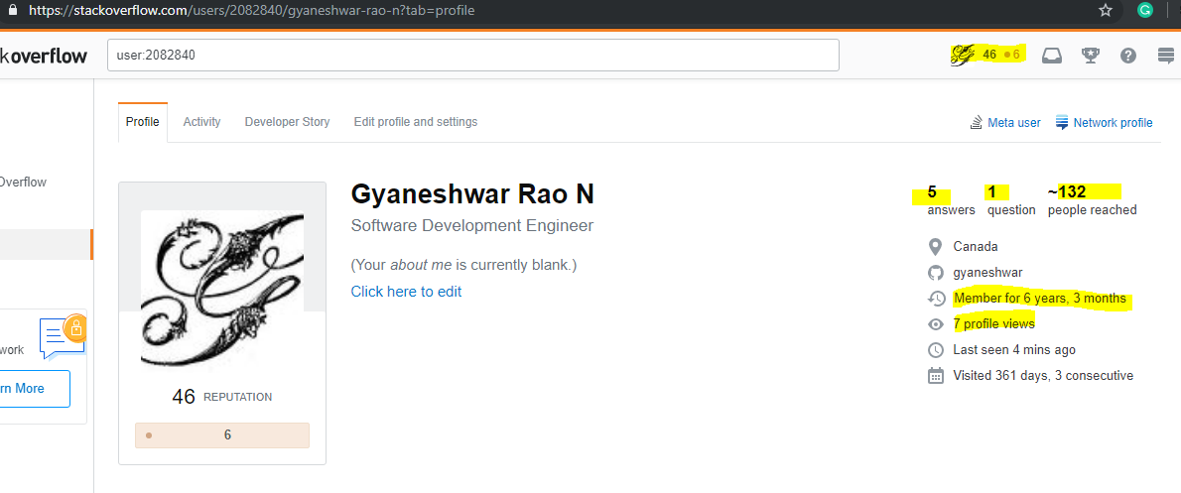
Stack Overflow Ranking

Slide 13
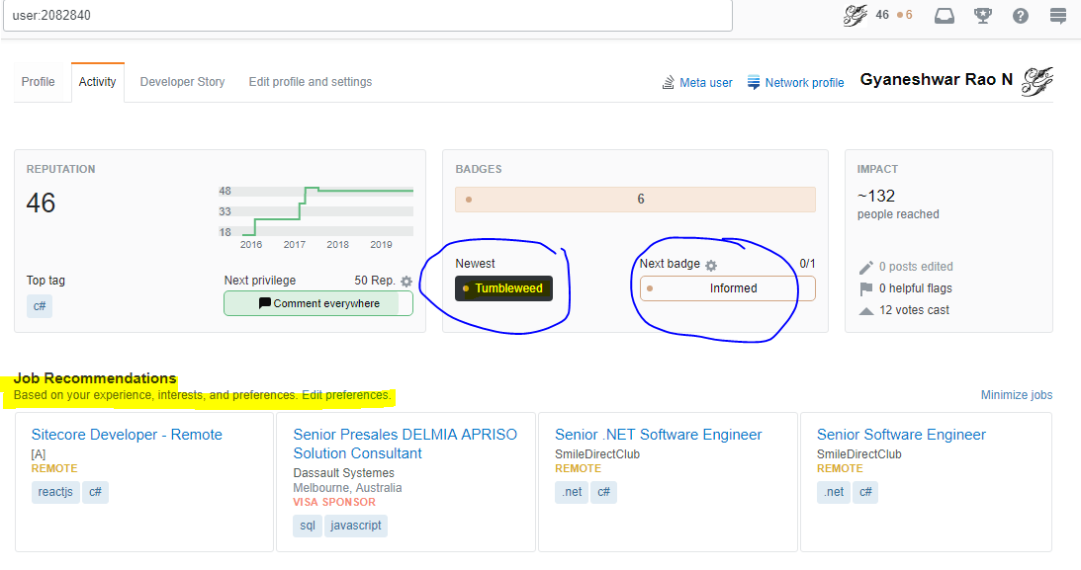

Slide 14
Story line
https://stackoverflow.com/story/gyaneshwar

Slide 15
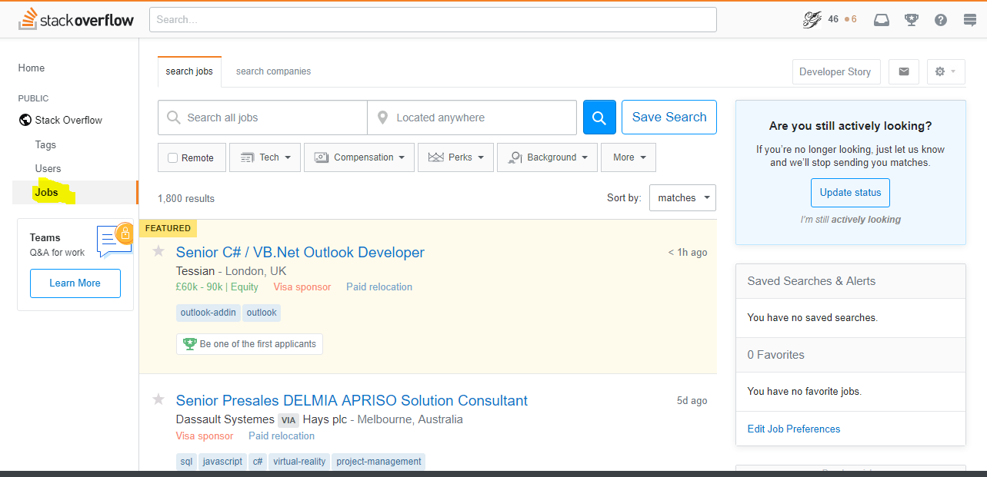
JOBS

Slide 16

AIM to
https://stackoverflow.com/users/22656/jon-skeet

Slide 17
Sites
https://stackexchange.com/sites

Slide 18
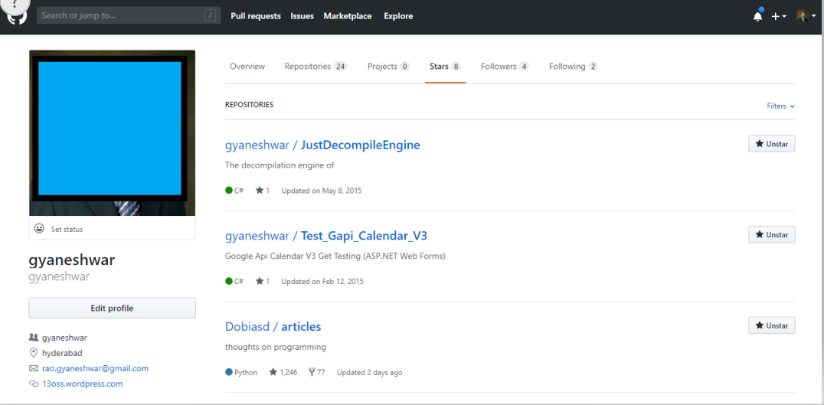
GitHub

Slide 19
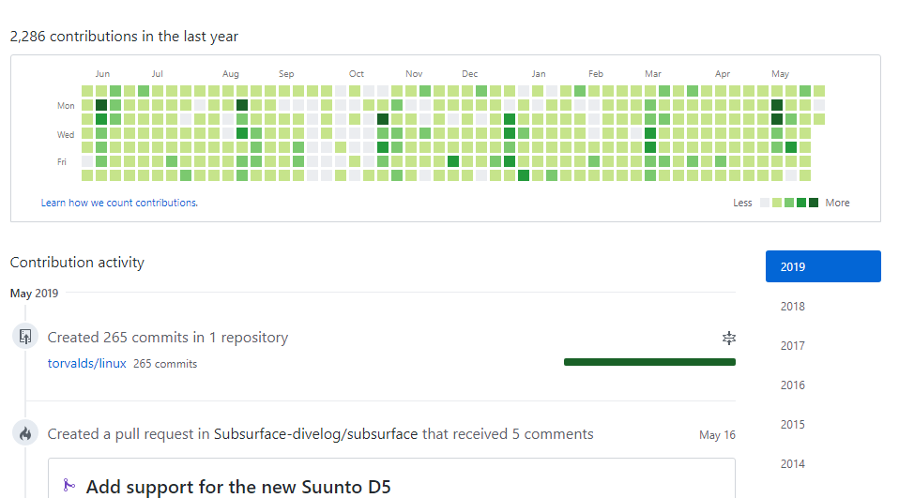
Contributions

Slide 20
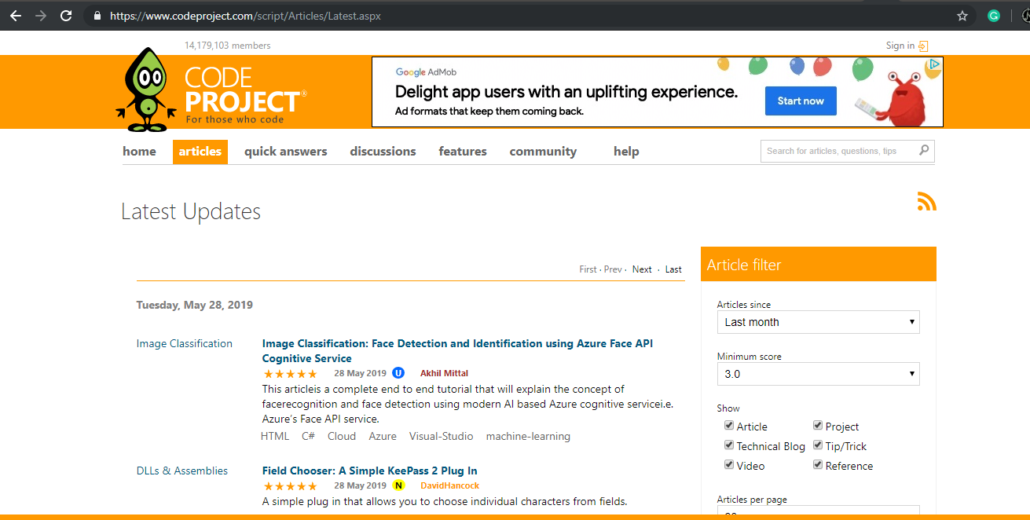
codeproject

Slide 21
Let me know if you know any?

Slide 22
Thank you

